Slide 1
Bubble Sort Algorithm (Discussed in lecture 2)
Advanced Algorithm Analysis

Slide 2
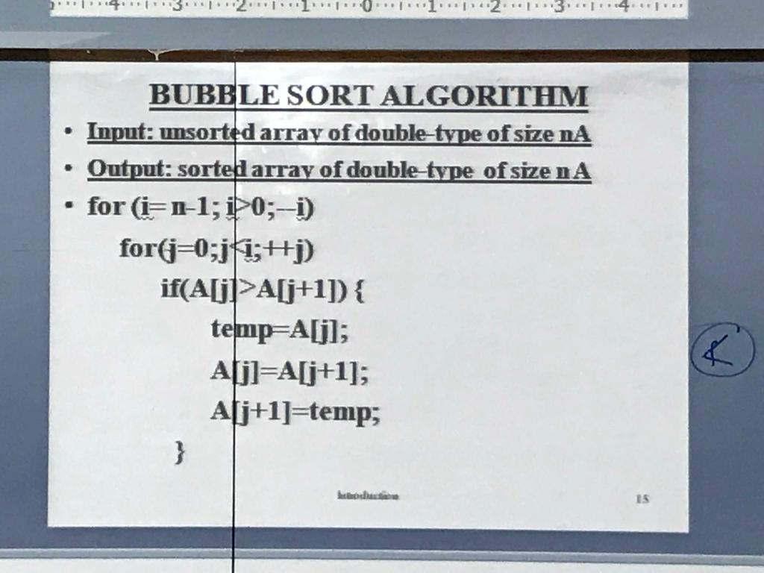
Bubble Sort Algorithm

Slide 3
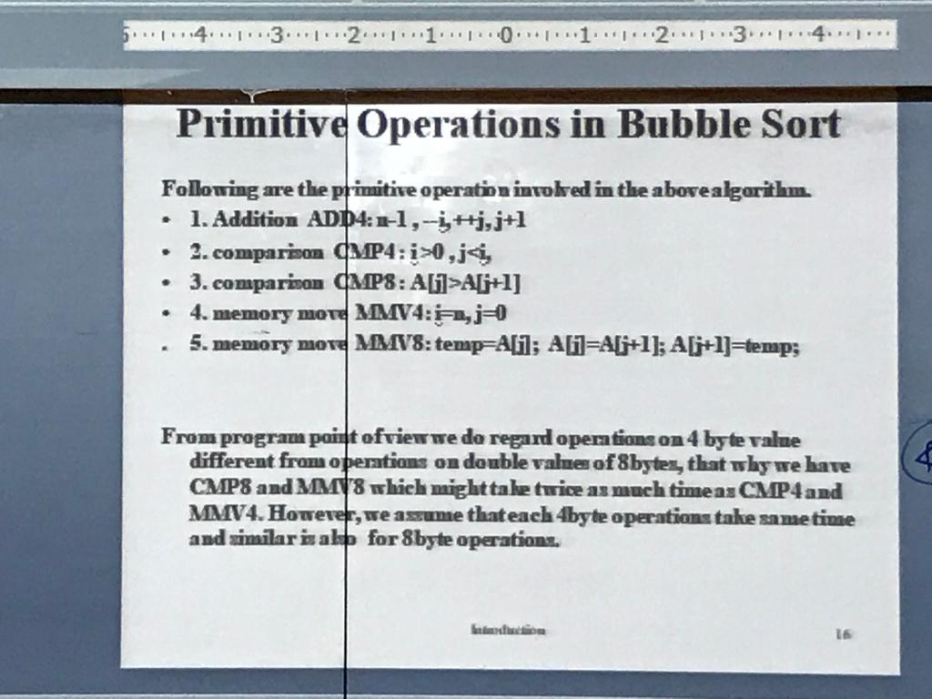
Primitive Operations

Slide 4
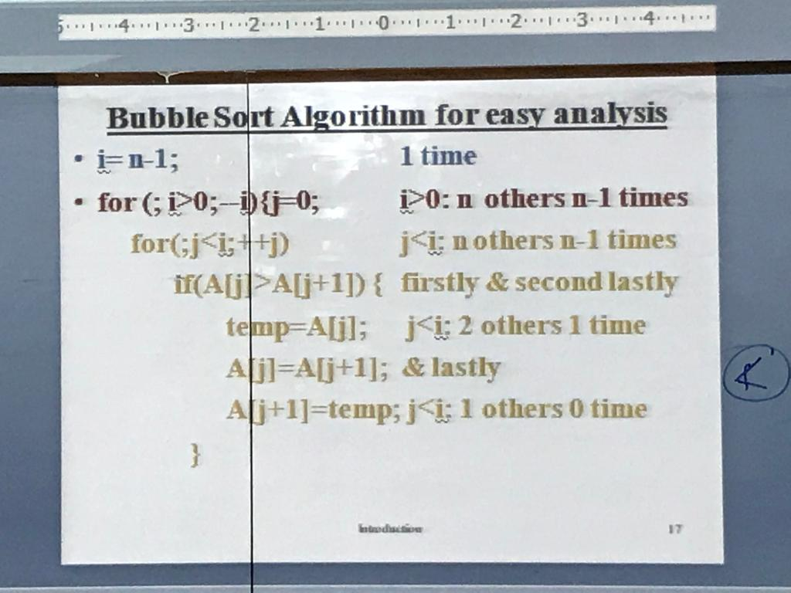
Bubble Sort Algorithm

Slide 5
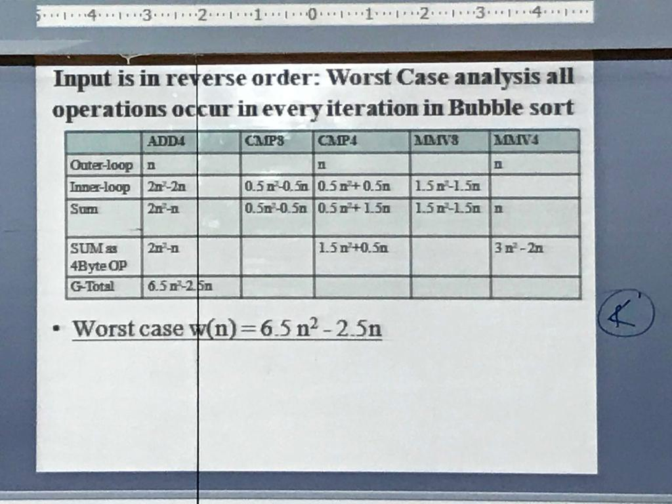
Growth of function (Bubble Sort)

